Slide 1
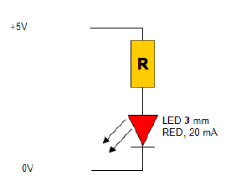
How to use the LED
It doesn’t matter which side you connect to the Microcontroller pin. Just set the output to logical high or low.
Make sure that you are not exceeding the current budget of your MC.
If you use the same I/O pin as input and output, then be careful not to create a shortcut.

Slide 2
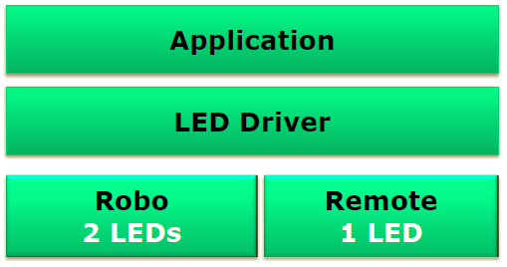
LED Driver - Motivation
Easy implementation:
We can use the ‘same’ driver for multiple platforms
No need of knowing the implementation details.
BitIO/LED component can be used as hardware abstraction

Slide 3
What shall the driver do?
Initialize and configure the hardware
Should be able to turn the LED on/off
Should be able to determine if a LED is on or off.

Slide 4
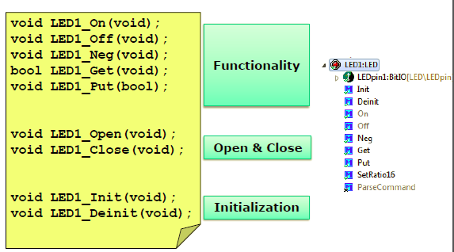
Driver interface

Slide 5
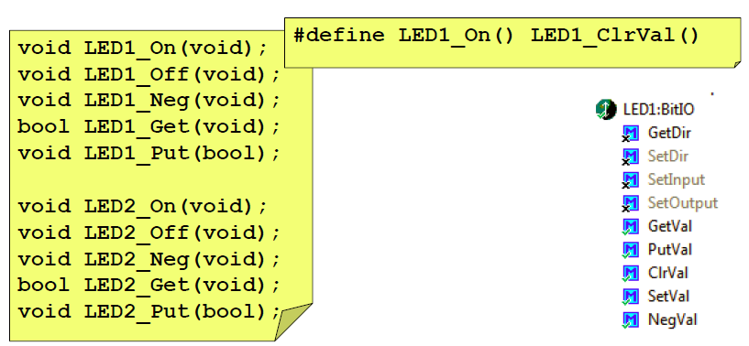
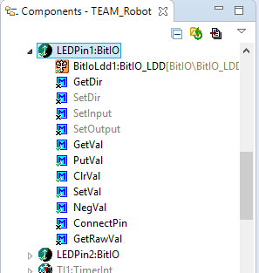
Implementation #4

Slide 6
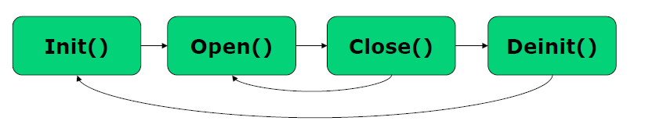
Device Driver Flow
Initialization/allocation of memory, data structure
Lock this device for other applications, get the device handle
Free device, return device handle
Free memory, reset the driver to default
1 2 3 4

Slide 7
Questions:
??

